Slide 1


Welcome to the Course
Kaushik Roy Chowdhury

Slide 2
This course is about Blazor, Microsoft’s latest web framework
So what is this buzzword Blazor heard quite frequently these days?

Slide 3
Course Features:
Follow along complete CRUD application
Application uses data protection feature to show user profile data to logged in users
Integration of Spinkit component to show cool animated indicators as the application loads
Concept building in Blazor through many hands-on coding examples
Emphasis on learning by doing rather than long theoretical discussions
End of the course assignment

Slide 4
Demo Of Completed Application
In this lecture we shall:
View a demo of the completed web application with all the features
The salient points of this CRUD application are
Demonstrates user authentication
It enforces user data protection(through authorization) to show only the user profile data to logged-in users
Integrates a SpinLoader component that presents animated CSS loading indicators

Slide 5
Blazor Installation & Configuration (Note: Please view the resources for the links)
Install the .NET Core 3.1 SDK
For Visual Studio perform the following:
Install Visual Studio Community 2019 with the ASP.NET and web development workload
For Visual Studio for Mac, do the following:
Install Visual Studio for Mac
Select File > New Solution or create a New Project
In the sidebar, select .NET Core > App
Select the Blazor Server App template. Only the Blazor Server template is available in Visual Studio for Mac at this time

Slide 6
Blazor Installation & Configuration(Visual Studio for Mac)
For a Blazor WebAssembly experience, follow the instructions on the .NET Core CLI tab. After selecting the Blazor Server template, select Next
Set the Target Framework to .NET Core 3.1 and select Next
In the Project Name field, name the app “Web Application1”. Select Create
Select Run > Run Without Debugging to run the app without the debugger. Run the app with Start Debugging to run the app with the debugger.
(If a prompt appears to trust the development certificate, trust the certificate and continue)

Slide 7
Blazor Installation & Configuration(Visual Studio Code)
Install Visual Studio Code
Install the latest C# for VS Code Extension
For a Blazor WebAssembly experience, execute the following command in a command shell:
dotnet new blazorwasm -o WebApplication1
For a Blazor Server experience, execute the following command in a command shell:
dotnet new blazorserver -o WebApplication1

Slide 8
Blazor Installation & Configuration(Visual Studio Code)
Open the WebApplication1 folder in Visual Studio
For a Blazor Server project, the IDE requests that you add assets to build and debug the project. Select Yes.
If using a Blazor Server app, run the app using the Visual Studio Code debugger. If using a Blazor WebAssembly app, execute dotnet run from the app's project folder.
In a browser, navigate to https://localhost:5001

Slide 9
Additional Tools
You can optionally download and install SQL Server 2019

Slide 10
Introduction to Blazor
Kaushik Roy Chowdhury

Slide 11
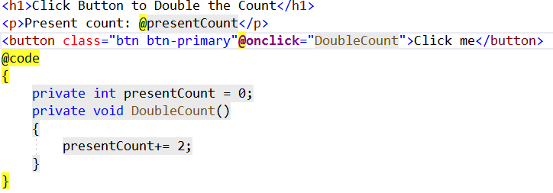
Introduction to Blazor
Blazor is a framework for building interactive client-side web UI with .NET

Slide 12
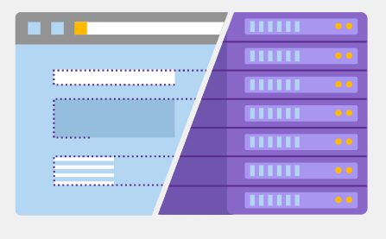
Introduction to Blazor
Blazor runs on WebAssembly or the Server
Photo Courtesy: https://dotnet.microsoft.com/apps/aspnet/web-apps/blazor

Slide 13
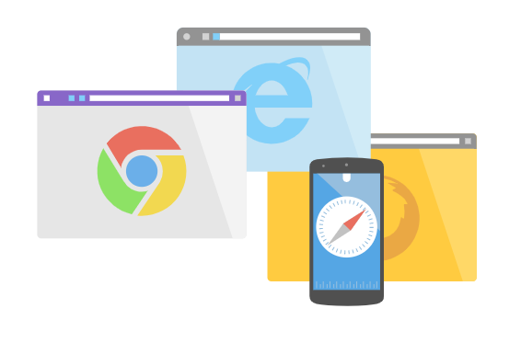
Introduction to Blazor
Blazor is built on open web standards
Photo Courtesy: https://dotnet.microsoft.com/apps/aspnet/web-apps/blazor

Slide 14
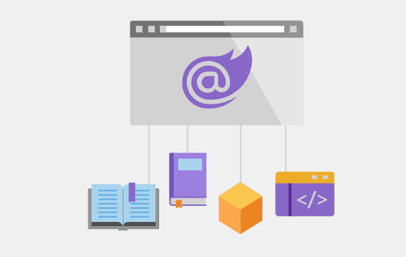
Introduction to Blazor
Sharing code and libraries
Photo Courtesy: https://dotnet.microsoft.com/apps/aspnet/web-apps/blazor

Slide 15


Introduction to Blazor
JavaScript interop
C#
JS

Slide 16
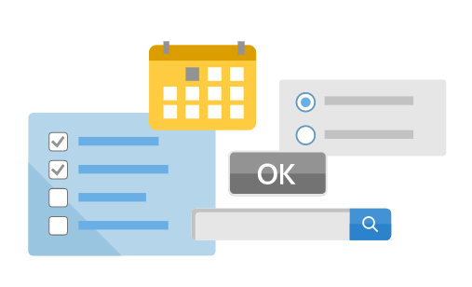
Introduction to Blazor
UI component ecosystem
Photo Courtesy: https://dotnet.microsoft.com/apps/aspnet/web-apps/blazor

Slide 17
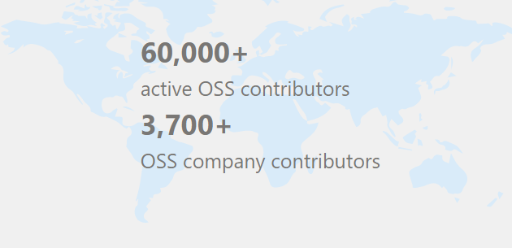
Introduction to Blazor
Open-source and free
Photo Courtesy: https://dotnet.microsoft.com/apps/aspnet/web-apps/blazor

Slide 18

Introduction to Blazor
Active Community
Photo Courtesy: https://dotnet.microsoft.com/apps/aspnet/web-apps/blazor

Slide 19
What’s new in Blazor in ASP.NET Core 3.1?
In this tutorial we shall discuss the following changes to Blazor Server Apps:
Support for partial classes
Component tags usage

Slide 20
What’s new in Blazor in ASP.NET Core 3.1?
In this tutorial we shall discuss the following changes to Blazor Server Apps:
Pass parameter to top-level components
Default action prevention

Slide 21
What’s new in Blazor in ASP.NET Core 3.1?
In this tutorial we shall discuss the following changes to Blazor Server Apps:
Stop event propagation
Detailed error handling during app development

Slide 22
Preview of Completed App
In this tutorial we shall see :
Preview demo of the completed application
Run the application
User test the application with data

Slide 23
Create your First Blazor Component
In this tutorial we shall learn to:
Create a razor component in Blazor
Analyse the code
Run the app to see the result

Slide 24
Create a Nested Component
In this tutorial we shall:
Create a child Dialog component in Blazor
Create a parent component that nests the child component
Learn about the parameter attribute
Learn the concept of RenderFragment
Run the app

Slide 25
Get Started with ASP.NET Core Blazor
Get Started with Blazor
Install the latest .NET Core 3 SDK release
Install the Blazor templates by running the following command in a command window :
dotnet new -i Microsoft.AspNetCore.Blazor.Templates::3.0.0-preview9.19465.2
Make sure you’ve installed the latest Visual Studio with the ASP.NET and web development workload
( I have installed the Visual Studio 2019 Community Edition and updated it to version 16.3 that has the required SDK already installed)

Slide 26
One-way data binding
In this lecture we shall learn:
In this lecture, we shall discuss the concept of one-way binding in Blazor
Build a one-way razor component in Blazor that increments a counter on a button click and toggles between two messages with different styles on a paragraph

Slide 27
One-way data binding
In One Way Binding
Updates to the value that a control has is unidirectional, or flows one way
To render a label with updated text dynamically is an example of one way binding
In Blazor, one way binding could be in response to the triggering of an event by the user, such as a button click
One way binding will modify the value of the label above as the user will not be able to do so directly
Event Triggered by User
Value gets Updated
Updated Value is Rendered(Shown)

Slide 28
Two-way data binding
In this lecture we shall learn:
In this lecture, we shall discuss the concept of two-way binding in Blazor
Create a Blazor component which collects form-based user data and demonstrates two-way data binding(by rendering user updated data on the browser immediately)

Slide 29
Two-way data binding
In Two Way Binding
It has a two direction flow, allowing values to be updated from two directions
As the user types in the data into an form input control, the data updates and renders on the browser
Two way binding can be used anywhere that an application needs a user input, primary use still being in forms
The main way that two way binding is used in Blazor is through the use of bind attribute

Slide 30
Two-way data binding
Bind Attribute Forms:
The bind attribute is a very flexible and versatile method for binding in Blazor
It has three different forms
The various forms allow developers to be specific about how to implement the binding
@bind = Property
@bind-value = Property
@bind-value = Property @bind-value:event = “onevent”

Slide 31
Two-way data binding
Conclusions:
We discussed the concept of basic two way binding in Blazor
Created a Blazor component which collects form based user data and demonstrates two way data binding(by rendering user updated data on the browser immediately)

Slide 32
Inheritance in Blazor
When a Blazor component is created it should inherit from ComponentBase class.
The first reason is that it implements IComponent interface which Blazor uses to locate components throughout the project
Secondly, ComponentBase contains important lifecycle methods which will be taken in another tutorial
In this tutorial, we shall see how a component can inherit a base class, CoolBlazorBase to provide its properties and methods

Slide 33
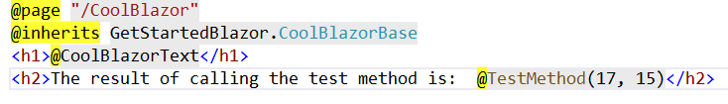
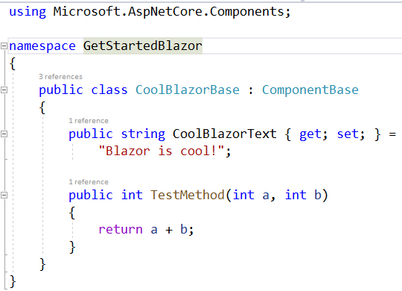
Inheritance in Blazor
Code: (CoolBlazor.razor)
CoolBlazorBase.cs

Slide 34
Lifecycle Methods in Blazor
In this lecture we shall study
What does lifecycle in Blazor means?
The lifecycle methods in Blazor

Slide 35
Lifecycle Methods in Blazor
Q1. What does a Blazor lifecycle refer to?
Lifecycle refers to the various stages during the creation, updating and disposal of instances of Blazor components
Lifecycle methods tap into the various key moments of the lifecycle
These methods are also known as lifecycle hooks
Q2. How these components can call the lifecycle methods?
Every Blazor component is derived from the Microsoft.AspNetCore.Components.ComponentBase class.
This class contains all the lifecycle methods which can be overridden for each component.

Slide 36
Lifecycle Methods in Blazor
Lifecycle method sequence:
OnParametersSet and OnParametersSetAsync:
They are invoked after SetParametersAsync and OnInit are finished and then each time new or updated parameters are received.
OnParametersSetAsync is called when the component performs an asynchronous operation
OnAfterRender and OnAfterRenderAsync:
They are called after a component has finished rendering when element and component references have been populated
We can perform additional steps such as activating third-party JavaScript libraries that operate on the rendered DOM elements
ShouldRender
Override ShouldRender to suppress UI refreshing
Even if ShouldRender is overridden, the component is always initially rendered

Slide 37
Lifecycle Methods in Blazor
Lifecycle method sequence:
SetParametersAsync:
Sets parameters to their respective properties and supplied by the component's parent in the render tree.
Also called each time new or updated parameters are received
OnInitialized and OnInitializedAsync :
They are invoked when the component is initialized after having received its initial parameters from its parent component
These methods are called only one time when the component is first instantiated
OnInitializedAsync is called when the component performs an asynchronous operation and should refresh when completed

Slide 38
Lifecycle Methods - SetParametersAsync
In this lecture we shall see the:
SetParametersAsync method in action in code

Slide 39
Lifecycle Methods – OnInitialized/ OnInitializedAsync
In this lecture we shall see the:
OnInitialized and OnInitializedAsync methods in action in code

Slide 40
Lifecycle Methods – OnParametersSet/ OnParametersSetAsync
In this lecture we shall see the:
OnParametersSet and OnParametersSetAsync methods in action in code

Slide 41
Lifecycle Methods – OnAfterRender/ OnAfterRenderAsync
In this lecture we shall see the:
OnAfterRender and OnAfterRenderAsync methods in action in code
( The code samples shown are courtesy: https://github.com/nativoplus/BlazorWorkshop )

Slide 42
Lifecycle Methods – ShouldRender
In this lecture we shall see the:
ShouldRender method in action in code

Slide 43
EventCallback
In this lecture we shall learn:
What are Event Callbacks?
How they help in exposing events across components?

Slide 44
EventCallback
A common scenario when there are nested components is that the parent component’s method should run when a child component’s event gets triggered
An EventCallback is used to expose events across components
In this case, a parent component can assign a callback method to a child’s EventCallback

Slide 45
Conclusion
Event Callbacks were seen and how they help in exposing events across components

Slide 46
Blazor Hosting Models
Kaushik Roy Chowdhury

Slide 47
Blazor Hosting
There are two hosting types for a Blazor App:
Blazor WebAssembly (Is in preview for ASP.NET Core 3.1)
Blazor Server (Supported in ASP.NET Core 3.0)
Blazor WebAssembly :
The principle hosting model for Blazor is running client-side in the browser using WebAssembly.
The app, its dependencies and the .NET runtime are downloaded to the browser
The app is executed directly on the browser UI thread (Fig1)

Slide 48
Fig 1
Browser
UI Thread
Blazor

Slide 49

https://.....
blazor
Fig 2
Razor Components
DOM
.NET
WebAssembly

Slide 50
Blazor WebAssembly (Pros) :
Apps run purely client-side
Such apps can be deployed to static site hosting solutions like GitHub Pages
.NET isn’t required on the server at all.
To get all the benefits of Blazor and full-stack .NET web development, host your Blazor WebAssembly app with ASP.NET Core
By using .NET on both client and server, we can easily share code

Slide 51
Blazor WebAssembly (Cons) :
Big download size
Requires support for WebAssembly
Less mature runtime
Debugging functionalities not so great
Still in preview
DLLs are also downloaded

Slide 52
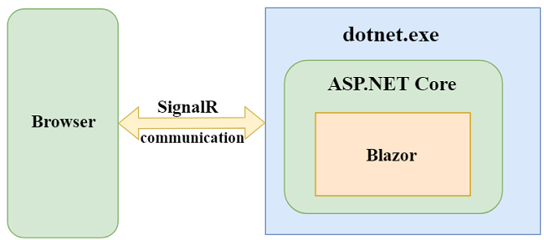
Blazor Server Side
Fig 3

Slide 53
Blazor Server (Difference from Client Side) :
Instead of downloading everything on the client and running on Web Assembly it uses
An ASP.NET Core application running on the server
Opening a real-time Signal R connection from the browser to the server

Slide 54
Blazor Server (Pros) :
No need for Javascript
Small size, fast loading
Use of .NET Core
Debugging works great as expected
Runs on any browser as no web assembly needed
Secure code as it never leaves the server

Slide 55
Blazor Server (Cons) :
Need for a server-side
No offline support(without server availability)
Higher latency and worse user experience
Hard to maintain and scale (as there are millions of Signal R connections to be managed if there are number of browser tabs opened by hundreds of thousands of users)
One of the solutions to the maintainability and scaling issues is to use Microsoft’s Azure SignalR service

Slide 56
Asynchronous Programming Fundamentals
In this lecture, we shall learn asynchronous programming concepts (which is essential for learning ASP.NET Core 3.1 Blazor)
Create and Run an ASP.NET Core 3 Console Asynchronous Demo Application with Visual Studio 2019

Slide 57
Asynchronous Programming Fundamentals
As per Microsoft, Task Class represents an asynchronous operation. In a few words, the Task class represents a single operation that doesn’t return a value and usually executes asynchronously
In simple words, an asynchronous operation consists of tasks that do not happen in sequence (one after the other) and can happen simultaneously(in parallel) or in different contexts.
These async operations occur on a thread pool thread rather than on the main thread as in a synchronous operation (which blocks it till the operation is over).
A juggler juggling with several balls at the same time with his hands to maintain balance so that they don’t fall off his hands is an example of asynchronous operation.
Another daily life example of a series of asynchronous operations is of cooking breakfast

Slide 58
Asynchronous Programming Fundamentals
What does async and await keywords mean in asynchronous programming?
The async keyword on a method means that it will be executed asynchronously. Await keyword signifies a point, usually a code block executing a long running operation, from where the control flow is returned back to the caller (without waiting for the operation to complete)
What is the purpose of the WaitAll() method commonly used in the Task class?
The WaitAll() waits for all of the provided Task objects to complete execution
(NOTE: This will be clear with the forthcoming demo on Visual Studio)

Slide 59
Create a CRUD Application in Blazor
In this tutorial we shall:
Create a Blazor (Server) App with Individual User Accounts

Slide 60
Create a CRUD Application in Blazor
In this tutorial we shall:
Run the Application and Inspect the Elements on the Browser

Slide 61
Create a CRUD Application in Blazor
In this tutorial we shall:
Understand the Project Structure

Slide 62
Create a CRUD Application in Blazor
In this tutorial we shall:
Understand the Program Class (Program.cs) and the Host Object

Slide 63
Create a CRUD Application in Blazor
In this tutorial we shall:
Understand the Startup Class

Slide 64
Create a CRUD Application in Blazor
In this tutorial we shall:
Understand the _Imports.razor file

Slide 65
Create a CRUD Application in Blazor
The following _Imports.razor file imports:
@layout MyCoolLayout
@using Microsoft.AspNetCore.Components
@using BlazorApp1.Data
MyCoolLayout.
All Razor components in the same folder and any subfolders.
The BlazorApp1.Data namespace.

Slide 66
Create a CRUD Application in Blazor
In this tutorial we shall:
Discuss the Shared Folder

Slide 67
Create a CRUD Application in Blazor
In this tutorial, we shall learn how to:
Create the application database and tables to store user and roles details

Slide 68
Create a CRUD Application in Blazor
In this tutorial, we shall learn how to:
Add User and Roles

Slide 69
Create a CRUD Application in Blazor
In this tutorial, we shall learn how to:
Implement Basic Authorization

Slide 70
Create a CRUD Application in Blazor
We shall discuss the basic authorization with <AuthorizeView> component
Later in the application, this will change to detailed authorization to show only authenticated user profile data (not all data to everyone)

Slide 71
Create a CRUD Application in Blazor
In this tutorial, we shall learn:
The directives as building blocks used in razor pages (Blazor Component)

Slide 72
Create a CRUD Application in Blazor
In this tutorial, we shall:
Create a Movie Class as Model for the Application

Slide 73
Create a CRUD Application in Blazor
In this tutorial, we shall learn how to:
Add the Movie Entity in the ApplicationDbContext

Slide 74
Create a CRUD Application in Blazor
In this tutorial, we shall learn how to:
Add the Migration and Create the Table

Slide 75
Create a CRUD Application in Blazor
In this tutorial, we shall learn how to:
Create an Interface for Data Access Service to Access the Movies Table

Slide 76
Create a CRUD Application in Blazor
In this tutorial, we shall :
Create a Data Access Service Class that Implements the IMovieDbService Interface
Add dependency injection to the public constructor of the class
Create methods to retrieve all the movies as a list and a specific movie by Id

Slide 77
Create a CRUD Application in Blazor
In this tutorial, we shall create :
Method to add a movie to the movies table in the database
Edit an existing movie and save the changes to the database
Delete a particular movie

Slide 78
Create a CRUD Application in Blazor
In this tutorial, we shall learn how to:
Register the Data Access Service to the Startup Class for further usage in the components

Slide 79
Create a CRUD Application in Blazor
In this tutorial, we shall learn how to:
Seed the database with some movie records

Slide 80
Create a CRUD Application in Blazor
In this tutorial, we shall learn how to:
Create the Details Page to List Movies from the Database
Modify the Navigation to Show the Clickable Navigation Menu for Movies

Slide 81
Create a CRUD Application in Blazor
In this tutorial, we shall learn how to:
Add Bootstrap to the Project (to use the Bootstrap Modal Dialog)

Slide 82
Create a CRUD Application in Blazor
In this tutorial, we shall learn how to:
Create a Razor Component as a Modal Dialog to accept User Inputs for Adding a New Movie

Slide 83
Create a CRUD Application in Blazor
In this tutorial, we shall learn how to:
Edit the Column of the Movies Table to Make them Non-Nullable

Slide 84
Create a CRUD Application in Blazor
In this tutorial, we shall learn how to:
Use Data Annotations to Validate User Inputs

Slide 85
Create a CRUD Application in Blazor
In this tutorial, we shall learn how to:
Saving Data to the Database

Slide 86
Create a CRUD Application in Blazor
In this tutorial, we shall learn how to:
Use JavaScript Interop to close the modal
dialog (still open after saving to database)

Slide 87
Create a CRUD Application in Blazor
In this tutorial, we shall learn how to:
Communicate between child and parent components (so that when the modal is closed on saving, the record added is visible without refreshing the browser)

Slide 88
Create a CRUD Application in Blazor
In this tutorial, we shall learn how to:
Edit a Movie Record

Slide 89
Create a CRUD Application in Blazor
In this tutorial, we shall learn how to:
Introduce Visual Difference (Titles) between Add and Edit Modal via Render Fragments

Slide 90
Create a CRUD Application in Blazor
In this tutorial, we shall learn how to:
Create the ConfirmDelete (Child) Modal to Confirm before Deleting a Record

Slide 91
Create a CRUD Application in Blazor
In this tutorial, we shall learn how to:
Edit the Movies.razor (Parent) Component to Complete the Delete Operation

Slide 92
Authentication of the Movies App
In this tutorial, we shall learn how to:
Introduce Authentication so that only Logged-in Users could View the Movie Records

Slide 93
Authorization of the Movies App
In this tutorial, we shall learn how to:
Authorize the logged-in users (authenticated) to view their user profile data (not all the data)

Slide 94
Authorization of the Movies App (Testing the Completed App)
In this tutorial, we shall:
Run the Movie app
Test the App with Movie Data

Slide 95
Loading Animated Indicators to the Movie App
In this tutorial, we shall:
Configure BlazorPro Spinkit (A collection of loading indicators animated with CSS for Blazor) into the app.

Slide 96
Loading Animated Indicators to the Movie App
In this tutorial, we shall:
Learn the usage of Spinkit(with Spinloader Component) into the Movies app
Run and Test the app with loading indicator

Slide 97
Loading Animated Indicators to the Movie App
In this tutorial, we shall:
Try a few Spinkit elements and see the animated loaders in action
Test the application without delay

Slide 98
Pagination of the Movie Records
In this tutorial, we shall:
Learn and do the pagination of the movie listing to display only a limited number of movies on a page

Slide 99
Migrating the Course Projects to ASP.NET 6.0
In this tutorial, we shall:
Show the migration path to the current ASP.NET 6.0 (for all the Visual Studio projects covered in this course)
Migrate the Blazor Movie App Written in ASP.NET Core 3.1 to ASP.NET 6.0

